Slide 1



MAR BASELIOS INSTITUTE OF TECHNOLOGY AND SCIENCE
NELLIMATTOM, KOTHAMANGALAM
DEPARTMENT
OF
ELECTRONICS AND COMMUNICATION ENGINEERING
ECD334 MINIPROJECT
ZEROTH REVIEW
Presented by:
Jesald Tony
Richard S Arreckal
Sreejith VB
S6 ECE
Guided by:
Prof. Teena Abraham, Asst Professor
Mr.Eldhose Joy, Tradesman
ECE DEPARTMENT

Slide 2
OUTLINE
Introduction
Block Diagram
Circuit Diagram
Components Required with Specification
Advantages & Applications
Conclusion
References

Slide 3
“TUNABLE FREQUENCY GENERATOR USING MINIMAL ANALOG COMPONENTS”
TOPIC NO: 1

Slide 4
1. INTRODUCTION
Designed using commonly available components for simple construction and maintenance
LM741 operational amplifiers generate stable and tunable oscillations
Resistors, potentiometers, and capacitors enable frequency adjustment
Zener and switching diodes ensure voltage control and signal stability
2N2222 and PN2907 transistors provide signal shaping and amplification
Suitable as a low-cost signal source for educational and laboratory use
Offers a clear demonstration of core analog electronics principles with minimal circuit complexity

Slide 5
2.BLOCK DIAGRAM
Frequency Control
(Potentiometer)
Oscillator
Signal shaping
Output
Amplifier/Driver

Slide 6
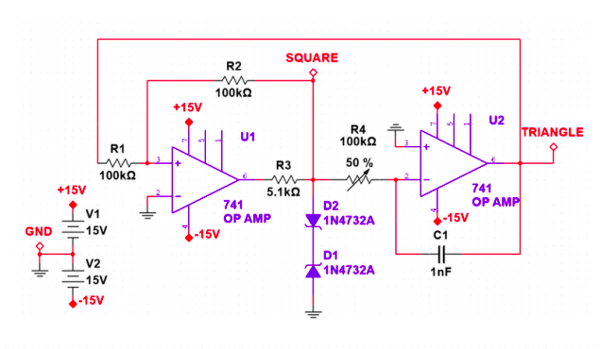
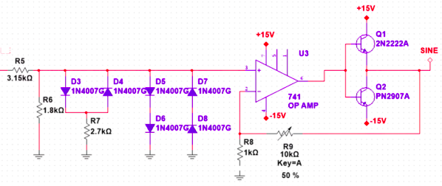
3. CIRCUIT DIAGRAM
Fig 2: Tunnable frequency Generator

Slide 7
4. COMPONENTS REQUIRED
LM741 Operation Amplifer
2N2222 NPN transistor
PN2907 PNP transistor
Zener diodes
Switching diodes
Potentiometer for frequency tuning
Capacitors

Slide 8
5. ADVANTAGES & APPLICATIONS
Low-cost and simple design using minimal analog components suitable for educational use.
Provides stable and tunable frequency output for testing and experimentation.
Easy to understand and modify, making it ideal for learning core analog electronics concepts.
Used for educational laboratory experiments and academic demonstrations.
Applied in signal injection and testing of electronic circuits.
Suitable for hobbyist projects and basic analog system evaluation.

Slide 9
TOPIC NO:2
“SMART IRRIGATION SYSTEM USING ARDUINO”

Slide 10
1. INTRODUCTION
The increasing demand for efficient water management has made automation essential in modern irrigation practices.
Traditional irrigation methods often lead to water wastage due to over-watering or delayed watering.
This project presents a smart irrigation system that automatically monitors soil moisture levels in real time.
An Arduino microcontroller processes sensor data to control a water pump based on predefined moisture thresholds.
The system ensures optimal water usage while reducing manual effort and human intervention.
By conserving water and supporting healthy plant growth, the system provides a cost-effective and sustainable solution for agriculture and home gardening.

Slide 11
2.BLOCK DIAGRAM
A
R
D
U
I
N
O
Water Pump(Motor/Relay)
Irrigation/water flow
Soil Moisture Sensor
Power Supply

Slide 12
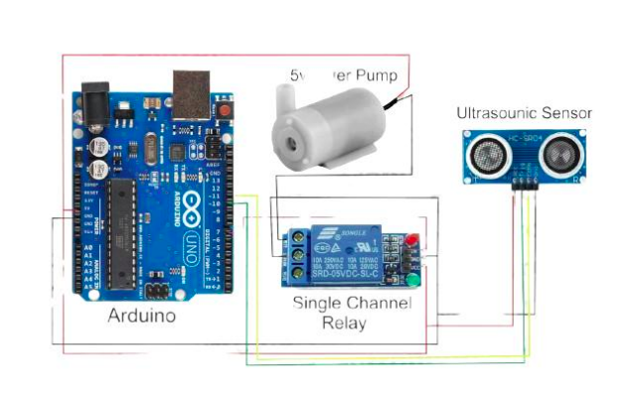
3.CIRCUIT DIAGRAM

Slide 13
4.COMPONENTS REQUIRED
Arduino microcontroller board
Soil moisture sensor
Water pump (DC pump)
Relay module or motor driver
External power supply or battery
Connecting wires
Breadboard or PCB
Water pipes or tubing

Slide 14
TOPIC NO:3
“SMART SHOPPING CART SYSTEM”

Slide 15
1. INTRODUCTION
The smart shopping cart system is designed to automate item detection and billing in retail environments.
The system uses an ESP8266 microcontroller along with an RC522 RFID reader to scan RFID-tagged products.
Scanned item details such as name, price, and wallet balance are displayed on an OLED screen.
A running list of purchased items is maintained for accurate and transparent billing.
The Blynk application enables remote monitoring and access to shopping data.
This system reduces manual effort, minimizes checkout queues, and supports a smart cashless shopping experience.

Slide 16
2.BLOCK DIAGRAM
RFID TAG
RFID reader module
ESP8266
WIFI MOBILE APP
OLED DISPLAY

Slide 17
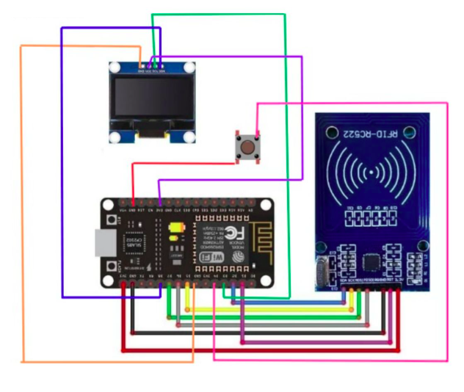
3.CIRCUIT DIAGRAM

Slide 18
4.COMPONENTS REQUIRED
ESP8266 microcontroller
RC522 RFID reader module
RFID tags
OLED display
Blynk mobile application
Power supply
Connecting wires
Breadboard or PCB

Slide 19
6. CONCLUSION
The selected projects demonstrate the practical application of electronics, embedded systems, and automation concepts.
Each project focuses on solving real-world problems using cost-effective and efficient technological solutions.
The frequency generator emphasizes core analog electronics and signal generation fundamentals.
The smart irrigation system highlights sensor-based automation and sustainable resource management.
The smart shopping cart showcases the integration of IoT and embedded systems for smart retail solutions.
Together, these projects reflect a balanced understanding of analog, digital, and IoT-based system design.

Slide 20
7. REFERENCES
Sedra, A. S., & Smith, K. C., Microelectronic Circuits, Oxford University Press – Reference for analog oscillators and frequency generator concepts.
Banzi, M., & Shiloh, M., Getting Started with Arduino, Maker Media – Reference for Arduino-based smart irrigation systems.
Kumar, S., & Pande, R., “RFID Based Smart Shopping Cart System,” International Journal of Engineering Research and Technology (IJERT) – Reference for RFID and IoT-enabled shopping cart systems.

Slide 21
THANK YOU

